Slide 1
Systematic review: MNEs in Violent conflict zones
Taeksang Jang

Slide 2
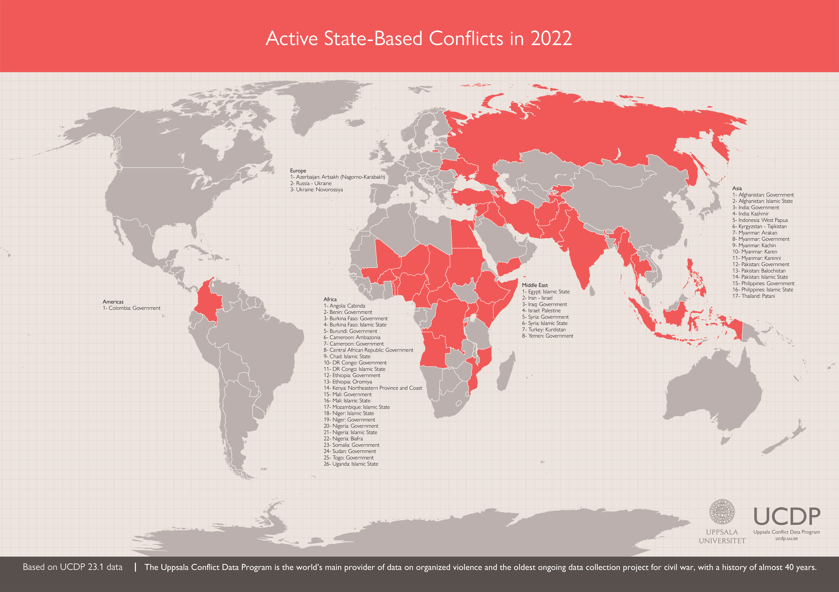
Violence across the globe
Motivation
Methodology
Main Findings
Angola Civil War, Afghan Civil War, Bosnian War, etc.
Ongoing Conflicts in 2022

Slide 3
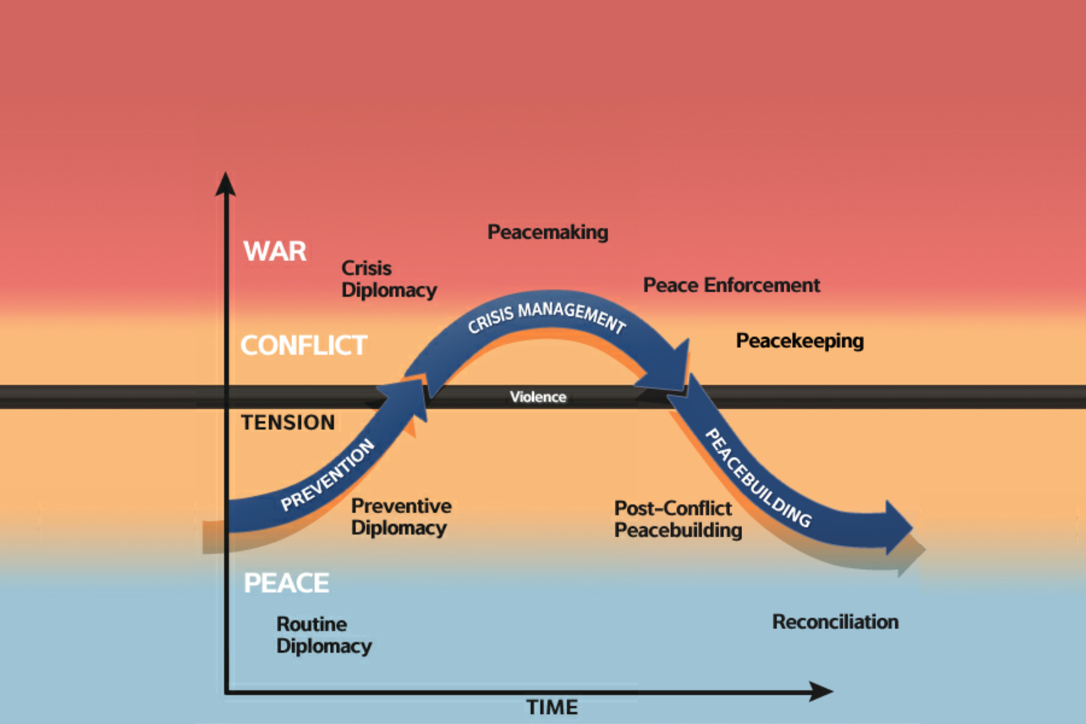
The temporal dimension of violent conflicts
Motivation
Methodology
Main Findings
2. During Conflict
1. Onset of Conflict
3. End of Conflict
Source: United States Institute of Peace (USIP)

Slide 4
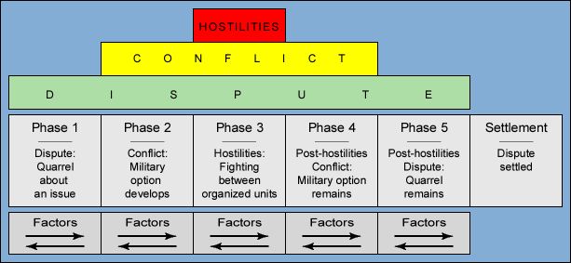
Holistic picture of the review
Motivation
Methodology
Main Findings
2. During Conflict: How to navigate?
3. End of Conflict :
i) How to foster peace?
ii) Re-enter?
1. Onset of Conflict:
i) Enter?
ii) Stay or Leave?
For this assignment
Figure: Bloomfield-Leiss dynamic model of Conflict
Source: MIT Cascon System for Analyzing International Conflict

Slide 5
Existing literature and the Need for a review
Motivation
Methodology
Main Findings
MNE Strategic Intervention in Violent Conflict: Variations Based on Conflict Characteristics (Getz, K. A., & Oetzel, J. (2009), JBE) => Since it is very costly to exit, MNEs have incentive to strategically respond to violent conflicts.
Business and Peace: Sketching the Terrain (Oetzel et al., 2009, JBE) => review the literature on the role of businesses in conflict resolution and peace building
Disasters and international business: Insights and recommendations from a systematic review (Nielsen, BB; Wechtler, H; Zheng, LL, 2023, JWB) => review the literature on man-made and natural disasters broadly in the field of IB
=> I seek to create an integrative framework of MNEs and conflicts zone that encompasses MNEs’ decisions with regards to their operations in conflict zones from the onset to resolution of violent conflicts.
=> But, for this research I focus on reviewing the literature on the the factors that influence MNEs’ decision faced with the existence of violent conflicts in its current or potential host countries.

Slide 6
Research question
Motivation
Methodology
Main Findings
(Enter, Stay, or Leave?)
What are the factors that influence multinational enterprises (MNEs)’s operational decisions in conflict zones?

Slide 7
Methodology
Motivation
Methodology
Main Findings
Phase | Description
Selecting Journals | Initial journal selection based on review from Pisani et al (2017) General Management journals, IB journals, and Business and Society Journals Added to this initial selection: Political Science and Economic Journals such as Journal of Conflict Resolution and Journal of Political Economy.
Constructing Search String | Selected keywords (Violent Conflicts & FDI or Operational decisions) TS=("civil war" OR "intrastate war" OR "interstate war" OR "political violence" OR "military dispute" OR "political conflict" OR "military conflict" OR "violent conflict" OR "civil conflict" OR "internal conflict" OR "external conflict" OR "ethnic conflict" OR "interstate conflict" OR "intrastate conflict" OR "armed conflict" OR "war zone" OR "conflict zone*" OR "terrorism" OR "terrorist" OR "assassination" OR "general strike" OR "purge" OR "riot" OR "anti-government demonstration" OR "coup" OR "political repression" OR "military repression" OR "government repression" OR "revolution" OR "rebellion" OR "insurgency" OR "genocide" OR "territorial dispute" OR "civil unrest" OR "political unrest" OR "non-state conflict" OR "one-sided conflict" OR "state conflict”) AND TS=("FDI" OR "foreign direct investment" OR "divest*" OR "exit" OR "stay" OR "suspend" OR "entry")
General Sample | Searched the title, keywords, and abstract of articles using Web of Science This resulted in an initial sample of 102 articles.
Final Sample | The inclusion criteria are The article studied MNE The article examined MNEs’ decision makings in conflict zones regarding enter, stay, or exit decisions. This resulted in a a selected sample of 32 samples

Slide 8
Journal composition
Motivation
Methodology
Main Findings
Management Journals | IB Journals | Business & Society Journals | Specialized Economic & Political Science Journals
Strategic Management Journal Organization Science | Journal of International Business Studies Journal of World Business Journal of International Management Multinational Business Review Management International Review International Business Review | Journal of Business Ethics Business & Society | European Economic Journal Journal of Conflict Resolution Journal of Politics Journal of Peace Research

Slide 9
The journal proportion of the Selected samples
Motivation
Methodology
Main Findings
Total: 32

Slide 10
Evolution of research on mne’s operational choice in conflict zones
Motivation
Methodology
Main Findings

Slide 11
More about sample articles
Motivation
Methodology
Main Findings

Slide 12
preliminary summary
Motivation
Methodology
Main Findings
Common Theoretical lens employed in the literature
Organizational Learning theory, RBV (Entry)
Neo-institutional theory (exit or stay)
(Entry) Mixed findings on the relationship between violent conflict in a host country and FDI. => highly dependent on the contextual factors (types, institutions, etc).
The widely accepted rationale are..
Increase in FDI: higher incentive to capture the host government authority
Decrease in FDI: higher transaction cost and institutional uncertainty.
(Stay or Leave) Highlight non-market factors that determine MNEs’ decisions
Divestment of peer firms
Institutional pressures
Relational capital in conflict zones

Slide 13
Broad themes and Key Findings
Motivation
Methodology
Main Findings
Type | Themes | Representative references | Main theoretical lens | Key findings
Antecedent | Conflictual drivers Military Conflict Civil war Terrorism Coup | Powers, M. & Choi, S.(2012); Camacho, A& Rodriguez, C.(2013); Tomashevskiy, A.(2016); Skovoroda, R., et al (2019); Dimitrova, A., et al (2022) | Neo-institutional theory; real options theory (growth options); TCE; OLI paradigm | (Entry) Terrorism in host countries contributes to a decrease of foreign investment into the countries. (Entry) Terrorist events are positively associated with US investment in Oil and Gas. (Entry) Armed conflict in host countries decrease FDI into the countries. (Entry) Risk of Coup is positively associated with increased FDI. (Stay or leave) Armed conflict increases the probability of plant exit. This effect is stronger for younger manufacturing plants, with a smaller number of workers and low levels of capital.
Moderators | Firm-level drivers Prior experience MNE network Country specific information accessibility | Ramos, M. & Ashby, N.(2013); Driffield, N., et al., (2013); Dai, L., et al (2013); Cornwell, AAD.,et al (2023) | Organizational learning theory, Neo-institutional theory, RBV | (Entry) Firms seek to leverage home experience with high levels of local organized crime, involving seemingly localized routines and practices, as they expand abroad. (Stay or leave) A more dispersed MNE network helps inside-conflict zone subsidiaries to survive and stay. (Stay or leave) Information accessibility shaped by in-country experience affects an MNE’s decision to stay or leave.
 | Institutional drivers Host country Governance quality Activist movement in a host country The type of host country political regime | Westermann-Behaylo, M., (2009); Oh, C. & Oetzel, J. (2011); Dimitrova, A. (2022); Owens, MD.(2023) | Neo-institutional theory | (Stay or leave) Higher quality governance lowers the likelihood of subsidiary-level divestment in response to terrorist attacks (Stay or leave) Institutional pressure affect divestment decisions of multinational firms from the conflict zone. (Entry) The host-country’s political regime i.e. anocracy weakens the negative effect of business-targeting terrorism on FDI inflows to MENA countries.

Slide 14
Conceptual framework of MNEs and conflicts zones
Motivation
Methodology
Main Findings
Moderators
Firm specific capability (FSA, CSA)
Inter-organizational effects (Imitation)
Institutional pressures (from host, home country, and global activists)
Antecedents
Strategic Decisions
Types of Violent Conflicts
Terrorism (Domestic, Transnational)
War (Military conflict, Civil war)
Political Violence (Coup, Protests)
Violent Organized Crime
MNEs and conflict zones
Enter
Stay or Leave

Slide 15
Key Literature gaps and Suggestions
Motivation
Methodology
Main Findings
Rather confined usage of theoretical lens=> Room for diverse application of different theoretical lens for both explanation and prediction.
Neo-institutional economics (North, 1995)
Stakeholder theory (Freeman, R. E., et al, 2010)
Real options theory in IB (Trigeorgis, L., & Reuer, J. J., 2017)
Competitive dynamics (Chen, 1996)
A large body of research focuses on explaining the antecedents of exits rather than stay => More research on the rationale for staying in a conflict zone can enrich the understanding.
For example, by combining outside-In perspective and inside-out perspective, we can provide a new insight of what internal factors (from individual to subsidiary, MNE network levels) tend to lead MNEs to stay in conflict zones.
Call for more qualitative or mixed methodological approach to shed light on the decision-making process of “stay or leave” decisions.
Few papers talk about the outcomes (financial or societal) of enter, stay or leave decisions into/from conflict zones.

